Slide 1

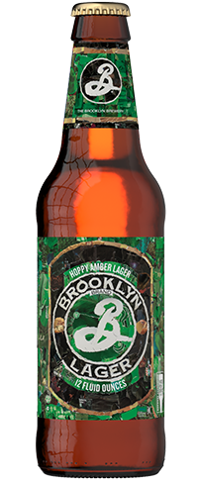
Miner League
Brandon Croom
Sangrae Cho
Sandesh Ojha
Beers and Breweries of America

Slide 2
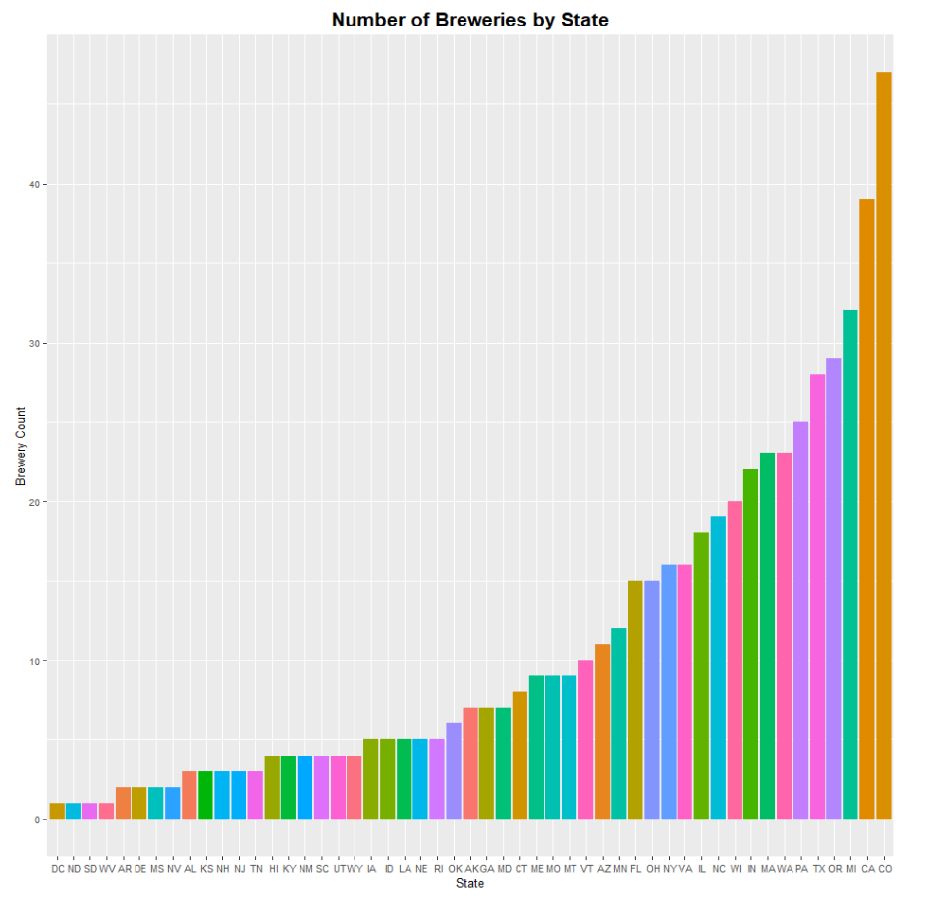
There are 558 Breweries which make Around 2,400 different types of Beers in the United States
1
The top 5 states produce 865(36%) of beers and represent 31% of the breweries in the US
These states include Colorado, California, Michigan, Oregon and Texas.
Two of the biggest states by population and size Texas and California also happen to have a lot of breweries than many other smaller states.
Despite not being a top 10 states based on size or population Michigan is one of the largest producers of beers in the US.
1
2
The bottom 20 states only produce 220(9%) of beers and only represent 8% of the breweries in the US
Despite it’s size and population New Mexico is one of the lowest producer of beer and only has 4 breweries.
2
Disclaimer : This analysis is based on a sample dataset

Slide 3
Even states with less than 5 Breweries produce Variety of Beers
2
1
1
Washington DC and Kansas have less than 5 breweries but per brewery they produce the highest numbers of beers at around 8.
The top 5 states produce around 5 different types of beers per brewery.
2
Disclaimer : This analysis is based on a sample dataset

Slide 4
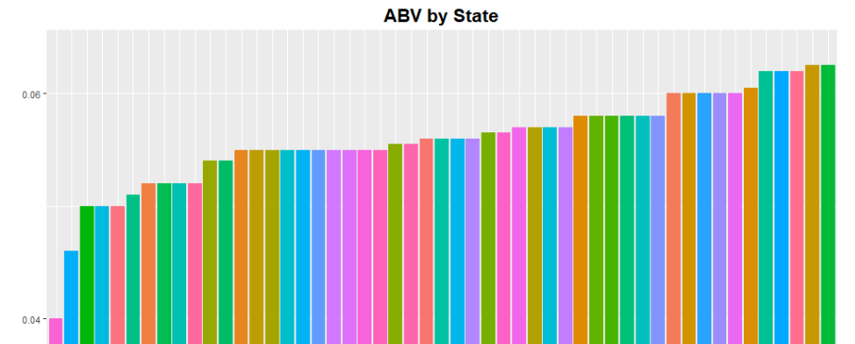
5% ABV Is becoming the Norm and there are select beers with much Higher ABV(10-13%)
3
1
2
1
Beers brewed in Utah (UT) and New Jersey (NJ) average between 4-5% for ABV, most other States are 5% or higher with Kentucky (KY) having the highest ABV.
36% of the beers are between 5-6% ABV and 21% between 6-7% ABV which represents more than half of the total beers.
Varieties of beers brewed in Washington DC also happen to have high ABV at 6.6%.
In terms of the Highest ABV, Colorado and Kentucky had the beers with the highest ABV at 13%.
2
3
4
Disclaimer : This analysis is based on a sample dataset

Slide 5
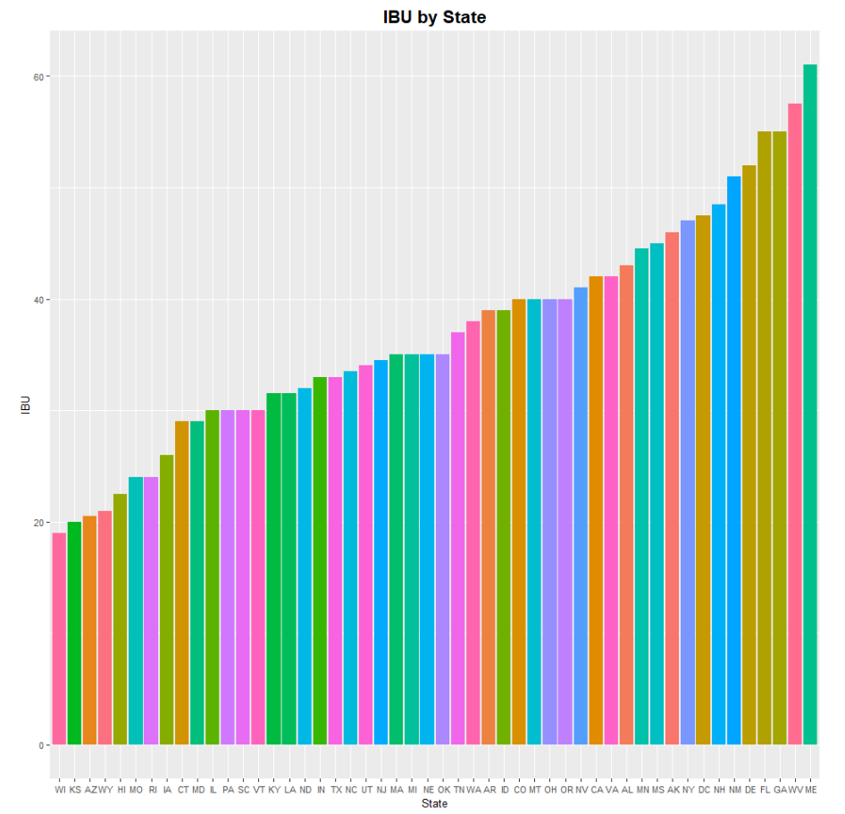
iPA’s are Bitter than most other Beer Styles.
2
Most beers (98%) of the higher IBU range(>=100) are IPAs.
The most bitter beer or the one with the highest IBU is from Astoria Brewing Company from Oregon(OR) at IBU of 138.
Maine(ME) has the highest median IBU while WV has the highest mean IBU.
Wisconsin(WI) has the lowest in terms of both mean and median.
1
1
2
3
3
Disclaimer : This analysis is based on a sample dataset

Slide 6
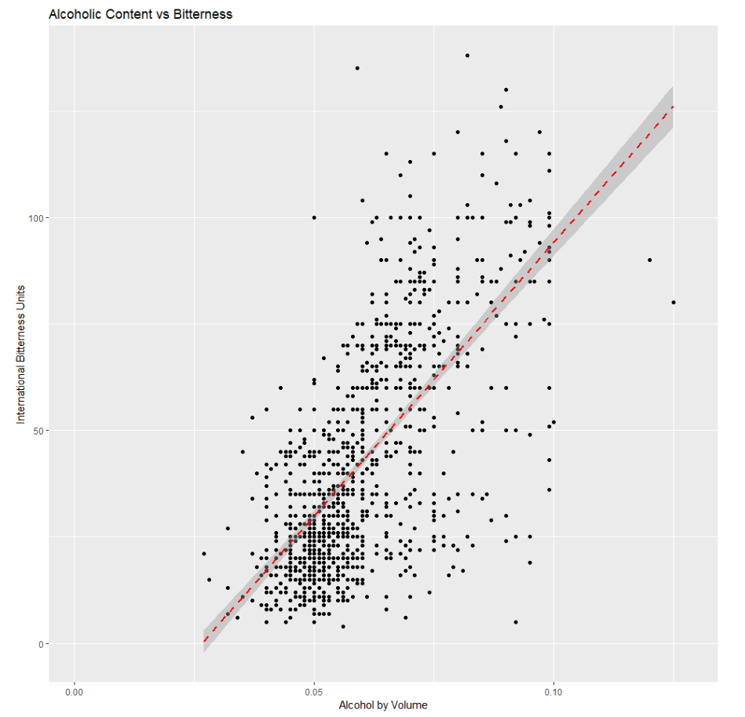
Beers with High International Bitterness Unit(IBU) are also High in ABV.
Based on our analysis we can concludes that alcoholic content (ABV) and bitterness (IBU) are significantly correlated with a correlation coefficient of 0.67 and p-value of <0.00001.
All Beers with IBU higher than 100 had ABV higher than 6%.
Beers in the 4-5% ABV range were all between 0-60 IBU.
Disclaimer : This analysis is based on a sample dataset

